Slide 1

The National Program on Dairy Markets and Policy
MPP-Dairy Update
  Overview of margin forecast for the year ahead
  Updates to MPP-Dairy Decision Tool
  Understanding financial risks farmers face
  Demonstrate new “Advanced Features” of decision tool

Slide 2
Remember When…
Notes:
It hasn’t been long since we felt that prices in the $15-$16 range were low and the $21-$22 range were high.
Last year the U.S. All Milk Price averaged about $25 for the whole year and now we’ve dropped into the low range again.
Big question is “Is this the bottom, or do we have further to go?”

Slide 3
MPP Ration Value
Notes:
Feed prices have also been volatile. An excellent corn crop last year helped push corn and other feed prices back down into a better level from the 2012 highs.

Slide 4
Annual MPP Margin
Highest Margin Ever!
Notes:
The MPP margin is the All Milk Price minus the ration value from the previous slide. All time high milk prices combined with declining feed prices gave us the highest MPP margin that we have ever seen.
A high margin—very profitable—year is a market signal telling producers that customers want more of their product. We have given them more, but the producer response has not been as strong as I would have expected.

Slide 5
Average Daily U.S. Milk Production
Millions of Pounds
Notes:
This chart shows the average daily U.S. milk production by months. You can certainly see the seasonality in our production but you can also see the trend of increasing production in this slide. But, it is hard to see whether the strong profits of 2014 gave a strong milk supply response or not.

Slide 6
Percent Change in U.S. Milk Production
Notes:
This slide looks at milk production a different way: as a percent change from the same month a year earlier. Our milk production trend is something like a 1-2% increase over time. There is a lot of variation around that trend in this chart, but our current milk production increases have been right about at that level. However, this national average masks some of the detail of geographic differences in milk production.

Slide 7
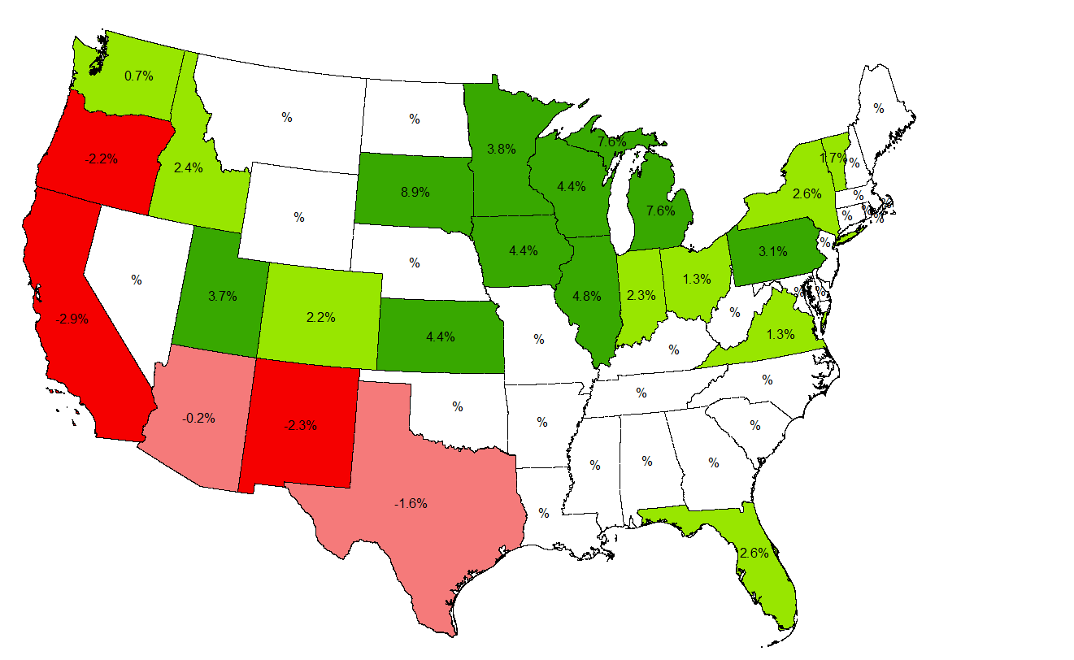
A Tale of Two Regions…
Notes:
This map shows the percent change in milk production for the first half of 2015 compared to the same months in 2014. You can clearly see that the western states have been declining in milk production while the more “traditional” dairy regions of the Upper Midwest and the Northeast have been increasing.
California, as the largest milk producing state, has been down nearly 3% while Wisconsin, the number two milk producing state, has been up nearly 4-1/2 percent. Those two states have just about offset each other’s milk production.
We have heard stories about milk dumping in the Northeast and Michigan. This isn’t because milk’s value is so low that a customer wouldn’t want it, but rather because there is enough plant capacity to handle all of the milk in those regions. Indeed, some of Michigan’s milk has been coming to Wisconsin to find processing capacity and we are at limit now too.

Slide 8
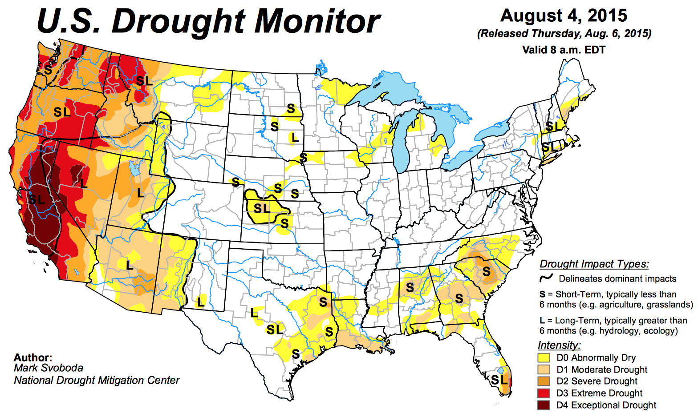
Worst CA Drought in 1200 Years
Notes:
The drought isn’t the entire reason that California has been losing milk production, but it is a big one, The severity of this drought predates our recorded climate history, which goes back nearly 200 years. You have to look at the growth rings in the blue oaks of California to determine that a drought this severe hasn’t been seen in about 1,200 years.
This is a severe drought which has been going on for about 4 years now. However, it’s impact has touched California’s dairy industry very much until this year. Now, water restrictions are impacting forage production and feed prices are high.

Slide 9
Comparative Feed Cost Data
Wisconsin
California
Price of Hay = $150
Price of Corn = $3.47
Price of SBM = $370
Price of Hay = $260
Price of Corn = $5.01
Price of SBM = $420
Notes:
Comparing Wisconsin’s feed prices to California’s it is easy to see that the feed cost of producing milk is now quite different between these two states.

Slide 10
Impact of Feed Costs
Notes:
Comparing Wisconsin’s feed prices to California’s it is easy to see that the feed cost of producing milk is now quite different between these two states.

Slide 11
All Milk Price
Notes:
It is also true that the milk price is also quite different between California and Wisconsin. You will note that in 2015 the difference is even larger than a historical average. That is because the product mix between the two states is quite different.

Slide 12
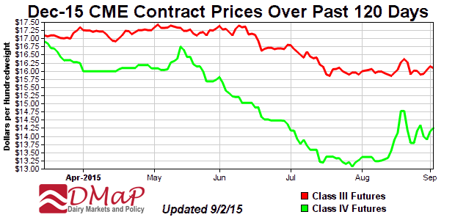
Opinions Change Over Time
Notes:
Wisconsin uses most of its milk to produce cheese which is a Class III milk price. California has a different milk pricing system, but much of their milk is used to produce milk powders which would be a Class IV milk price in a federal order. You can see that the price opinion at the Chicago Mercantile Exchange has been eroding over the last 4 months but much more so for Class IV milk than Class III contracts.

Slide 13
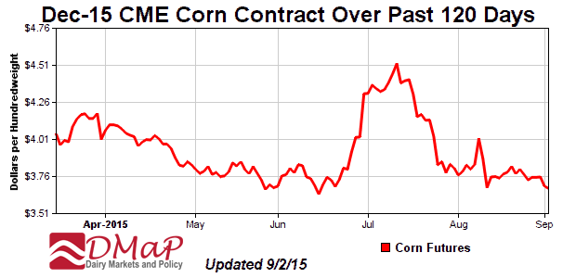
Opinions Change Over Time
Notes:
The CME opinion of corn futures has been volatile too. When we got news that cool, wet weather in the eastern portion of the corn belt had damaged crops, the futures price of corn jumped almost 75¢ a bushel in a few days time. However, when additional reports began coming in which indicated that much of the crop was in better condition than recently thought, the price declined again.

Slide 14
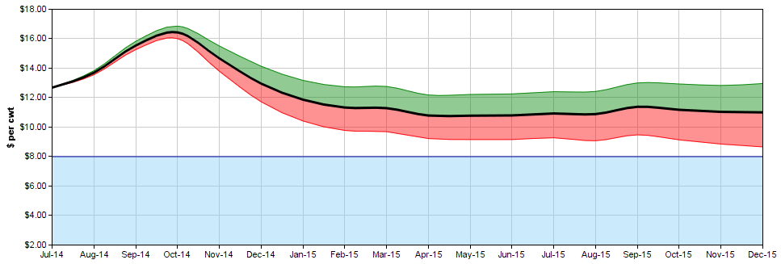
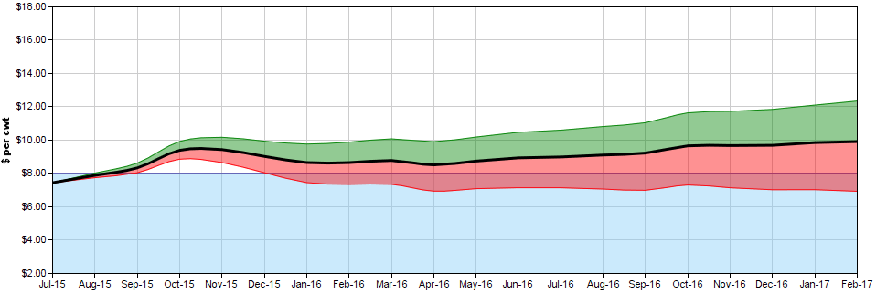
MPP Margin Forecast
Opinion as of Sept 30, 2014
Opinion as of Sep 2, 2015
Notes:
We use the futures prices on milk corn and soybean meal to estimate the All Milk Price and the ration value for the MPP program. The decision tool helps to forecast the expected margin over time. You can see that last year as of the closing of the sign-up period, the opinion of the 2015 production year was projecting something like a $10.50 margin. A long run average MPP margin is about $8.50 so that was a very strong forecast following the incredible 2014 year which had a more than $13 margin.
However, what has happened is that milk price pressures have pushed the margin down to about the $8 level from January 2015 until the present and the current opinion is for the rest of 2015 to also be in the $8 range.
The forecast for 2016 is for the first half of the year to be at the $8 level and then rise to nearly $10 by the last quarter.
We know that futures markets can’t perfectly forecast prices, but let’s consider what the chances are that they may be too high or too low…

Slide 15
Consumer Confidence
Notes:
There is a monthly survey of consumer confidence in the economy. Questions are asked about “how do you feel about the economy today” and also “what do you think the economy is going to do in the future”. This is the “Present Situation” and the “Future Expectations” in the graph respectively. The red Consumer Confidence line is just the average of the two values.
Notice that back in 2005-2007 consumers felt that the present situation was great but there was concern about the future. In those circumstances, consumers get conservative with their spending and don’t tend to buy those luxury items or go out to eat in restaurants as much. This almost becomes a self-fulfilling prophecy as their spending drops and we tumbled into recession in 2009.
In 2009, and through 2011 consumers were indicating that the present situation was awful with housing defaults, bank failures, etc., but they were optimistic about the future. That optimism has pulled the economy back up to a fairly good place. We are eating out of the home more again and our domestic sales of dairy products has been very strong.
Note: in 2015 we are again seeing consumers saying that the present situation is better than they expect the future to be. Let’s be hopeful that this isn’t a prelude to another economic downturn, but we should at least take a cautious note.

Slide 16
We Need Exports!
Notes:
We cannot depend on our domestic sales of dairy products alone. You can see in the chart that export sales now account for 15-16% of our milk production. You can also see back in 2009 that when other countries were experiencing the global recession, that many of them did not want to purchase as much of our dairy products. That was about a 2% decline in the amount of our milk production that didn’t get exported and those products had to be adsorbed into our domestic markets. That was the major reason for the 2009 collapse in milk prices.
You can also see that we are experiencing a decline in export sales from the peak last year. It isn’t quite a 2% drop, but it is big enough to notice. This should also be a warning that our milk prices could further soften.

Slide 17
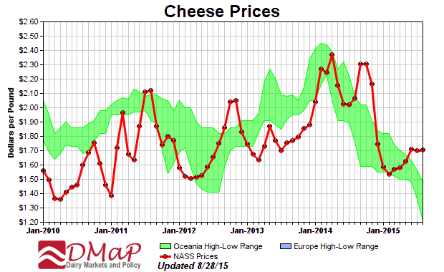
U.S. Versus International Prices
Notes:
This chart shows the U.S. price of cheese in the red line and the high-low range for Australia-New Zealand cheese in the green band. Our normal price relationship is to be at the bottom of the Oceania range or selling somewhat at a discount to their prices into world markets. Today, our prices are higher and we aren’t competitive in world markets.

Slide 18
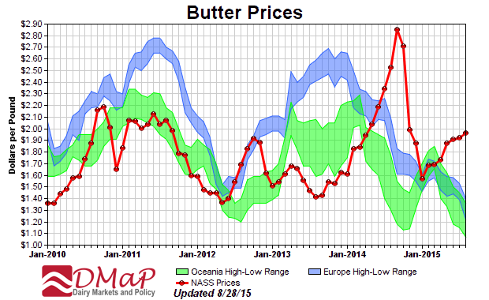
U.S. Versus International Prices
Notes:
The same story is true for other products like butter. The U.S. is high enough relative to the other exporters that they are sending butter to the U.S.
The U.S. skim milk and whey powder prices are however competitive in world markets and we are exporting those products today.

Slide 19
Global Dairy Trade Index
Notes:
New Zealand conducts an auction every other week to sell dairy products into world markets. The auction value of those products is compiled into the Global Dairy Trade Index seen in the slide. That index is a good barometer of the value of dairy products in world markets. The index is currently at it’s lowest point ever and has been in decline since 2014. It is interesting to note that these world prices began their decline in 2014 while the U.S. enjoyed the biggest milk price year ever.

Slide 20
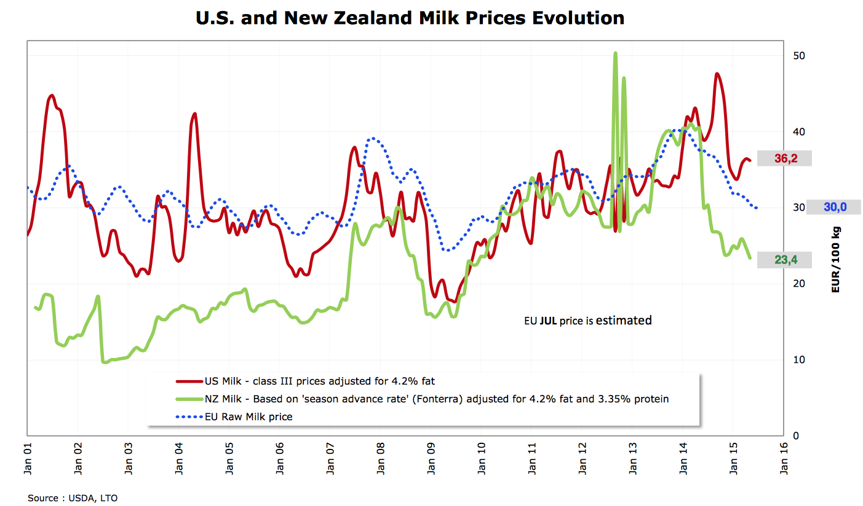
U.S. Farm Milk Prices are Holding Up Better than Most
$18.38
$13.61
$10.61
Notes:
This chart shows farm milk prices in the U.S., the European Union and New Zealand. Our prices have been much higher than those other two exporters in large part because our domestic markets have been so strong. However, if we are uncompetitive with world market prices and that 15% our our production stays here at home, our prices will fall too until we are again competitive in the world markets.

Slide 21
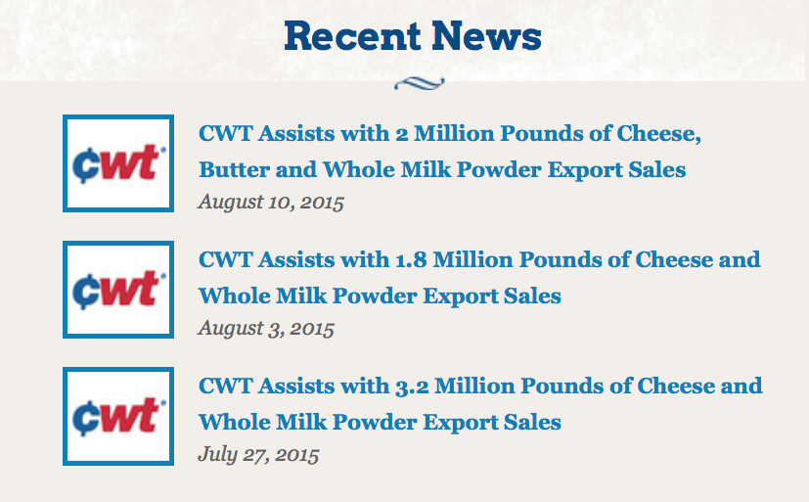
Exports Need a Boost
Notes:
We have been managing to export some cheese but that has largely been due to Cooperatives Working Together, or CWT, subsidizing those exports. That will become increasingly hard to do and at some point, CWT will have to back away and let market prices fall to levels that clear the markets of product.

Slide 22
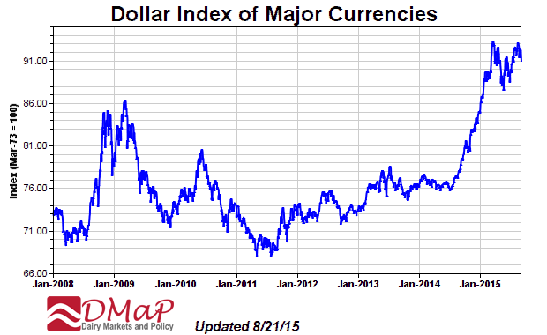
Other Factors
Notes:
The value of the U.S. dollar relative to other currencies has also provided stiff headwinds for exporters. The U.S. is still seen as a safe haven by the rest of the world in uncertain times and there has been a flight of investment from overseas into the U.S. which has strengthened the value of our dollar. That may sound like a good thing, but it means that it takes more foreign currency to purchase U.S. goods and it makes it harder for us to export dairy products.

Slide 23
Around the World
Notes:
Last year, the U.S. had a fairly normal increase in milk production, but other major exporters like New Zealand, Australia and the EU had much stronger increases. Note that part of New Zealand’s increase was due to being measured against the drought impacted production in 2013, but it was still a very large increase in production.

Slide 24
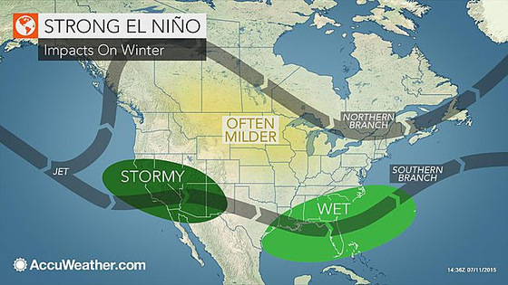
Can We Tap on the Brakes?
Strongest El Niño in 50 Years!
Notes:
One thing that might help put world dairy markets back into better balance is El Niño. This is a warm body of water that periodically develops in the Pacific ocean. Climatologists are saying that the current El Niño that is forming is the strongest in 50 years. An El Niño impacts weather patterns across the globe. It yields strong storms along our west coast, which could help alleviate some of the drought issues, and it usually give the Upper Midwest a milder winter.
However, the dairy market impact is what El Niño does on the other side of the Pacific. It can cause persistent high temperatures and sever drought in Oceania. In their pasture based dairy system, this would put the brakes on world milk production and help clear markets of excess product.

Slide 25
The Option to Producing Milk
Notes:
Right now, an option to producing milk in the U.S. is to cull marginal cows. The cull cow price remains very strong and about double what it was in the last downturn of milk prices in 2009.

Slide 26
My Forecast…
Our strong U.S. economy is helping consume dairy products
Dairy exports will become more of an issue in the next few months
I think that the MPP margin will be worse than futures forecasts now suggest through the first half of 2016
Notes:
Taken in whole, I suspect that there is more downside potential for milk prices than the futures markets is currently forecasting than upside potential. That is why I think we are in a very different place heading into this MPP election period than we were last year.

Slide 27
OLD APPROACH TO DAIRY RISK MANAGEMENT
I KNOW WHERE PRICES ARE GOING! – You selectively hedge only when you disagree with the market consensus. Let’s be frank, you’re speculating. ☺
DAIRY POLICY AS A PROFIT OPPORTUNITY – If subsidies are high, sign up, otherwise skip it.
“LEARN RISK MANAGEMENT!” – Extension, DMaP, brokers and policy makers all shoving risk management down your throat.
Notes:
With the 2009 year selected and returning to the farm stress test, you can see that without MPP the farm would have lost $2.42 per cwt. and the working capital would have gone negative and well below the $500 level that a banker would like to see. Solvency was also pushed into the territory where the farm would be having a very uncomfortable talk with the banker.
However, you can also notice that at higher levels of coverage—say up to $7.50 or $8.00—2009 never happened for this farm. The substantial indemnity payments that the farm would receive would make 2009 about a break-even year and liquidity would be maintained. Solvency was impacted though as asset values decline. However, this farm remains in business.

Slide 28
NEW APPROACH TO DAIRY RISK MANAGEMENT
FRAGILE – If your farm would have serious problems surviving a major downturn in profit margins.
ROBUST – If your financial position and cost of production allow you to withstand a very large and prolonged unexpected downturn in profit margins.
ANTIFRAGILE – If your farm benefits from milk and feed price volatility. For example, if you have very strong financial position, low cost of production, and have protected against downside in margins. Then as your competitors go out of business, you will have an opportunity to buy their farm at a great price.
Notes:
With the 2009 year selected and returning to the farm stress test, you can see that without MPP the farm would have lost $2.42 per cwt. and the working capital would have gone negative and well below the $500 level that a banker would like to see. Solvency was also pushed into the territory where the farm would be having a very uncomfortable talk with the banker.
However, you can also notice that at higher levels of coverage—say up to $7.50 or $8.00—2009 never happened for this farm. The substantial indemnity payments that the farm would receive would make 2009 about a break-even year and liquidity would be maintained. Solvency was impacted though as asset values decline. However, this farm remains in business.

Slide 29
NEW APPROACH TO DAIRY RISK MANAGEMENT
Our goal today, is to give you a tool to answer one key question:
Is my farm fragile, robust, or antifragile?
To answer that question, you need to:
Know your farm (costs of production, financials)
Execute a ruthless stress-test analysis
Notes:
With the 2009 year selected and returning to the farm stress test, you can see that without MPP the farm would have lost $2.42 per cwt. and the working capital would have gone negative and well below the $500 level that a banker would like to see. Solvency was also pushed into the territory where the farm would be having a very uncomfortable talk with the banker.
However, you can also notice that at higher levels of coverage—say up to $7.50 or $8.00—2009 never happened for this farm. The substantial indemnity payments that the farm would receive would make 2009 about a break-even year and liquidity would be maintained. Solvency was impacted though as asset values decline. However, this farm remains in business.

Slide 30
NEW APPROACH TO DAIRY RISK MANAGEMENT
Our goal today, is to give you a tool to answer one key question:
Is my farm fragile, robust, or antifragile?
To answer that question, you need to:
Know your farm (costs of production, financials)
Execute a ruthless stress-test analysis
Notes:
With the 2009 year selected and returning to the farm stress test, you can see that without MPP the farm would have lost $2.42 per cwt. and the working capital would have gone negative and well below the $500 level that a banker would like to see. Solvency was also pushed into the territory where the farm would be having a very uncomfortable talk with the banker.
However, you can also notice that at higher levels of coverage—say up to $7.50 or $8.00—2009 never happened for this farm. The substantial indemnity payments that the farm would receive would make 2009 about a break-even year and liquidity would be maintained. Solvency was impacted though as asset values decline. However, this farm remains in business.

Slide 31
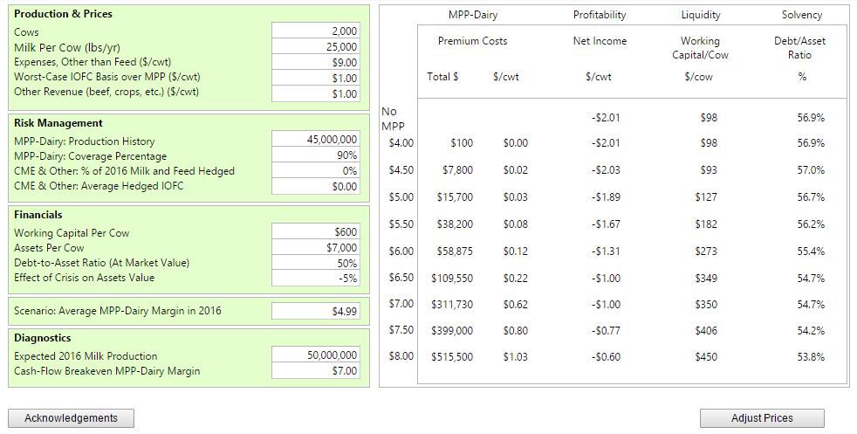
Know your farm: plans, costs and financials

Slide 32
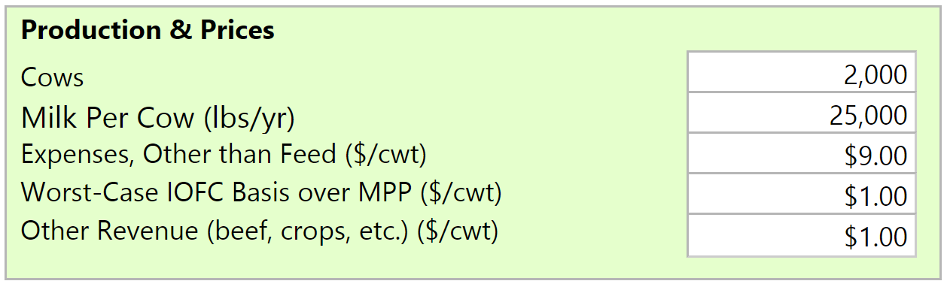
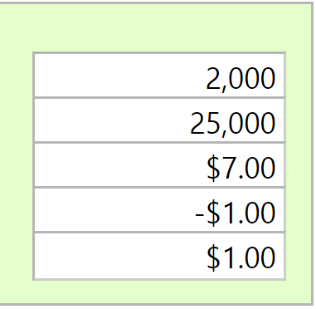
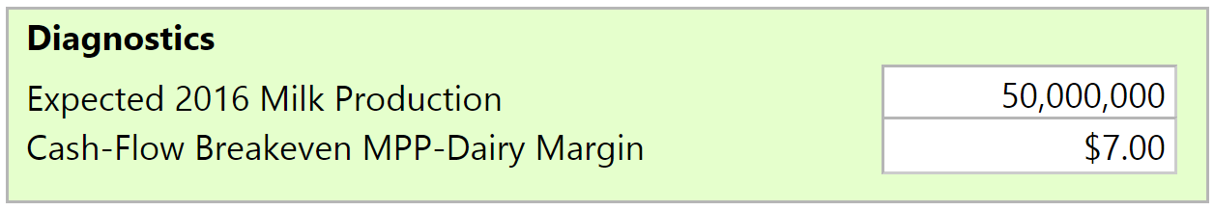
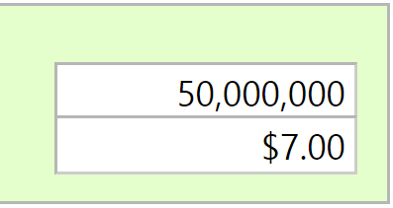
farm-specific dashboard: production & prices
Basis tends to be lower in regions where costs of production are lower.

Slide 33
MPP-Dairy: income over feed costs margin basis

Slide 34
Other operating costs
(excluding feed, herd replacement, depreciation)

Slide 35
dashboard: production & prices – Key Points
Historical average MPP-Dairy margin is approx. $8.50/cwt.
Basis tends to be lower in western United States.
Basis tends to be lower in regions where costs of production are lower.
Most dairies, across the entire country, will have MPP-Dairy cash-flow break-even point below $8.50/cwt.

Slide 36
Know your farm: plans, costs and financials

Slide 37
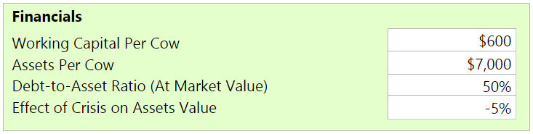
farm-specific dashboard: farm financials
Working capital per cow: Any losses will first be absorbed by cash reserves or by utilizing operating lines of credit.
Debt-to-Asset Ratio: If losses are deep and cannot be absorbed by working capital, long-term debt will be increased.
Assets Per Cow: Farms will more land will be able to spread losses over more assets.

Slide 38
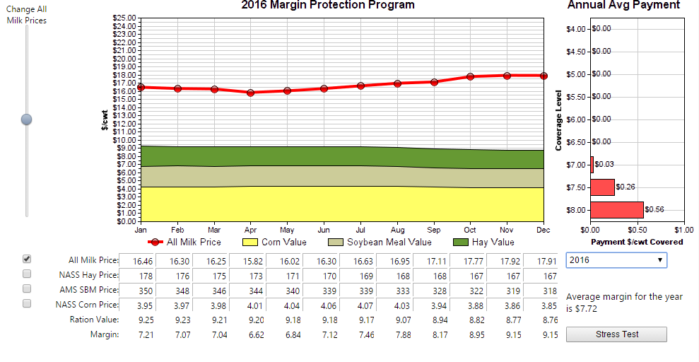
name your own price (be ruthless)

Slide 39
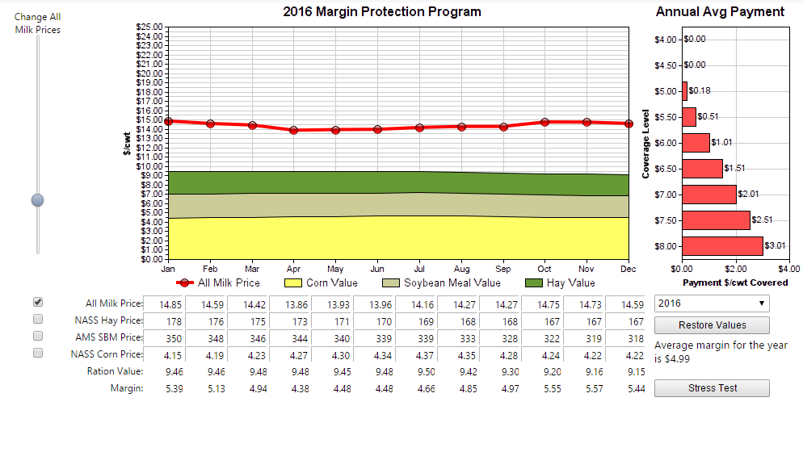
name your own price (be ruthless)

Slide 40
Know your farm: plans, costs and financials

Slide 41
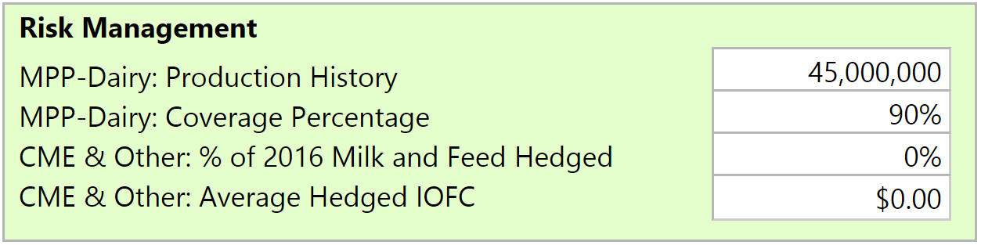
farm-specific dashboard: risk management
Some common question include:
Do I need to hedge if I use MPP-Dairy? How much?
Should % hedged plus coverage percentage be lower than total milk production?
When should I hedge?

Slide 42
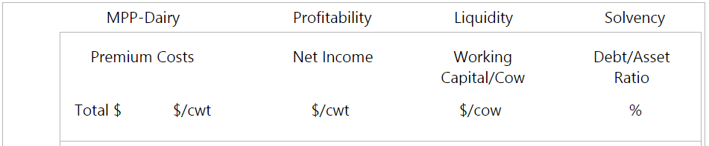
farm-specific dashboard: risk management

Slide 43
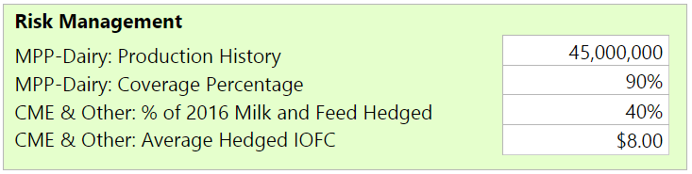
farm-specific dashboard: risk management

Slide 44
dashboard: risk management – key points
MPP-Dairy and private risk management tools may be combined to keep profitability, liquidity and solvency above desired thresholds at least hedging costs.

Slide 45
Questions?

